Slide 1
IEEE 39 Bus Contingency Analysis

Slide 2
System Information
Total generation: 6167.33 MW
Max Capacity: 6779.24 MW
Reduced generator Max MW to 112% of generator output for non-solar generators
Assuming that solar generators cannot increase their MW output
Capacity left: 611.91 MW
Total load: 6124.5 MW

Slide 3
Total Generation vs Max Capacity
Pre-Contingency Total Generation = 6167.33 MW
Tripped Generator | Max MW Capacity | Total Gen < Max MW | Capacity Left MW
30 | 6499.24 | √ | 331.91
31 | 6166.24 | x
32 | 6051.24 | x
33 | 6071.4 | x
34 | ------------- solar | ------------- solar
35 | 6051.24 | x
36 | ------------- solar | ------------- solar
37 | 6174.44 | √ | 7.11
38 | 5849.64 | x
39 | ------------- FO Target | ------------- FO Target

Slide 4
Load Relay Setting
Referencing WECC’s Off-Nominal Frequency Load Shedding Plan [1]
“Under frequency relays must have a max operating time of 6 cycles (0.1s) for high speed trip”
“System average operating time of breakers used to trip load is to be no more than 14 cycles (0.23s)”
Set Stage 1 frequency pick up: 59 Hz
Pickup time: 6 cycles (0.1s)
Breaker time: 3 cycles (0.05s)
Shed 10% of total load
0.1* 6124.5 = 612.45 MW
[1] https://www.wecc.org/Reliability/Off-Nominal%20Frequency%20Load%20Shedding%20Plan.pdf

Slide 5
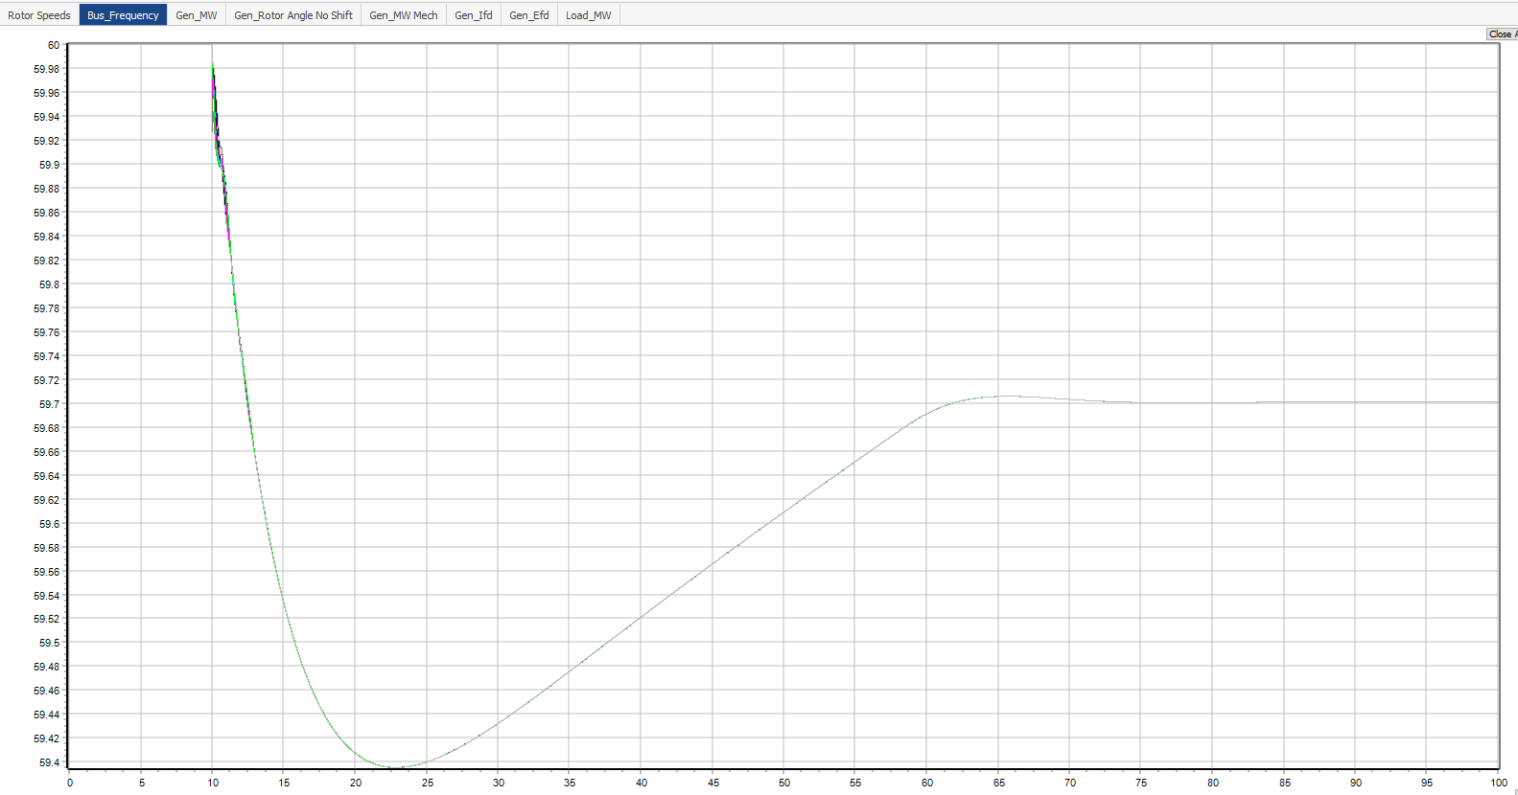
Trip Gen 37 Only
Contingency: Trip Gen 37
Trip Gen 37 @ 10s
Lowest frequency occurs at approximately 23s
Increase total load around this time to further drop the frequency
Min Freq

Slide 6
Contingency 1: Gen Trip and Load Increase Event

Slide 7
Contingency 1
Contingency:
Trip Gen 37 @ 10s
540 MW output generation disconnected
Pre-contingency max capacity decreased by 604.8 MW
Increase Load 39 by 25 MW @ 20s
Ideally:
Total generation > Max capacity
Recall: ~7 MW capacity left post generator contingency
However, there is an issue with how Power World does its transient analysis calculations

Slide 8
Power World Calculation Issue
Load 39 does increase by 25 MW, however, there is a decrease in the rest of the loads
Results:
Total generation decreased by 8.4855 MW
Total load decreased by 10.6525 MW
Solution: Increase Load 39 until total generation > max capacity
Increase load 39 by 50 MW or more
 | Pre-Contingency MW | Post-Contingency MW | Difference: Post - Pre
Generation | 6167.3274 | 6158.8419 | -8.4855
Load | 6124.5 | 6113.8475 | -10.6525

Slide 9
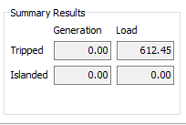
New Contingency 1
Trip Gen 37 @ 10s
Increase Load 39 by 50 MW @ 20s
Results
612.45 MW of load tripped
Contingency: Trip Gen 37 with Load Increase

Slide 10
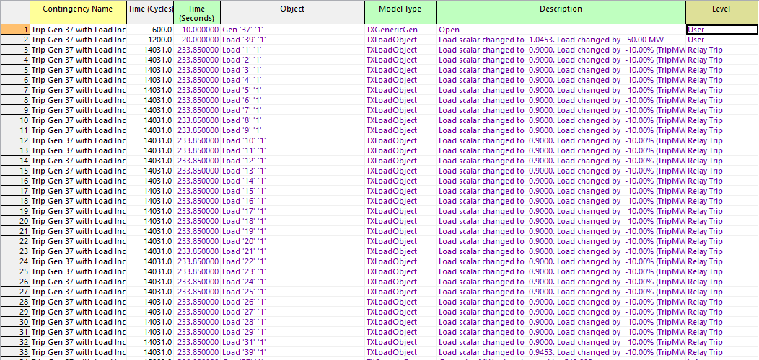
Contingency 1 Events
Contingency Event
Load Relay Load Shedding Events

Slide 11
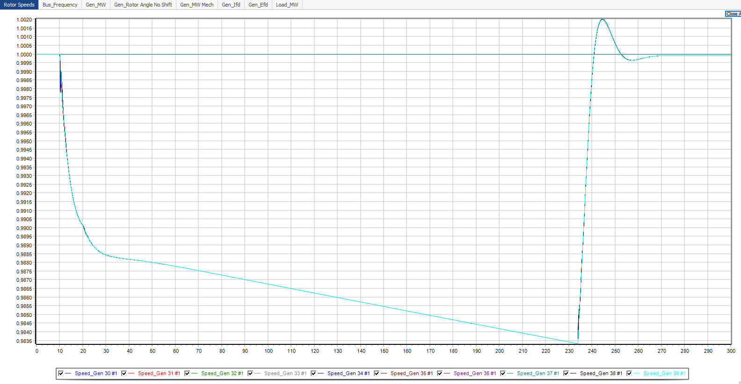
Contingency 1 Results

Slide 12
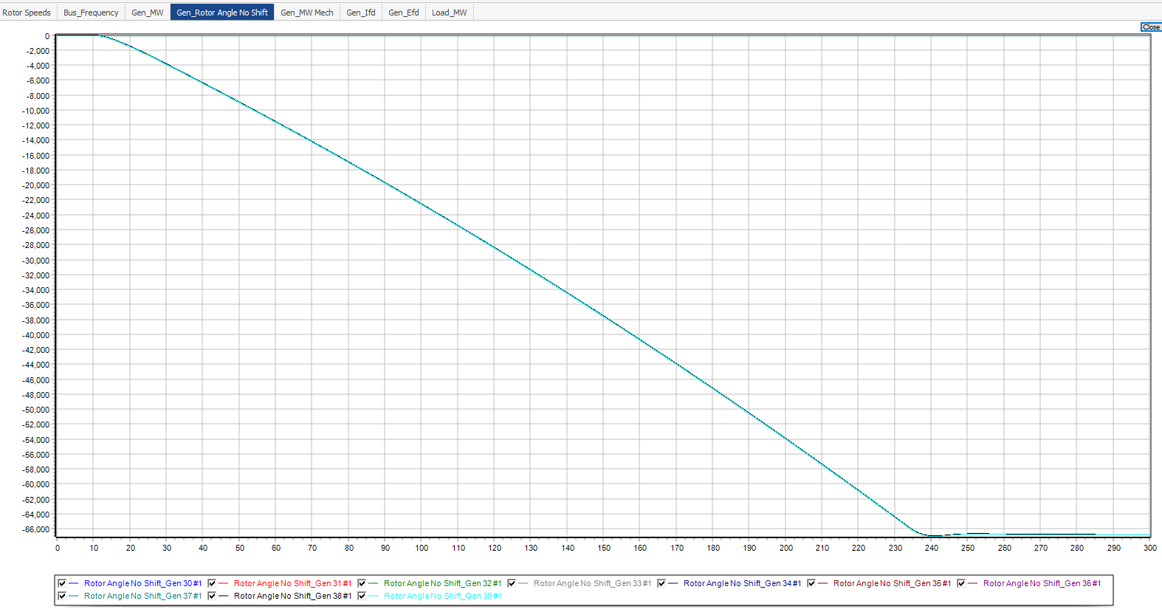
Contingency 1 Results

Slide 13
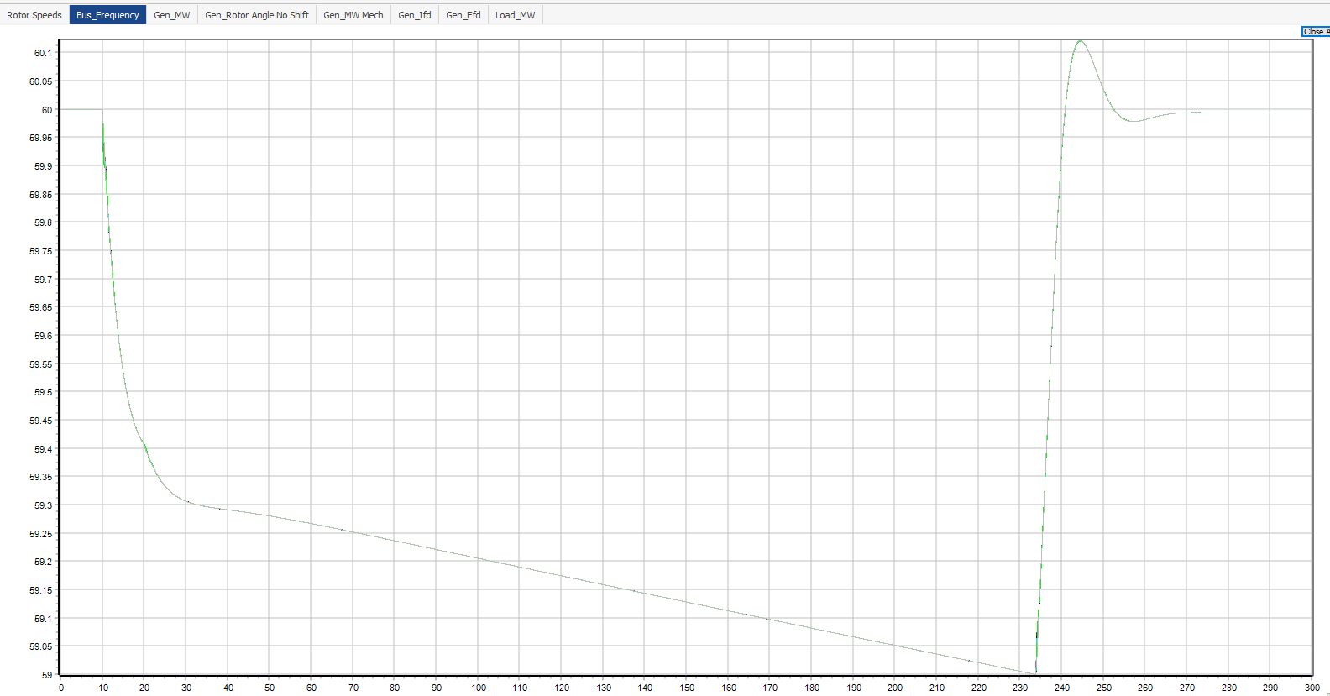
Contingency 1 Results

Slide 14
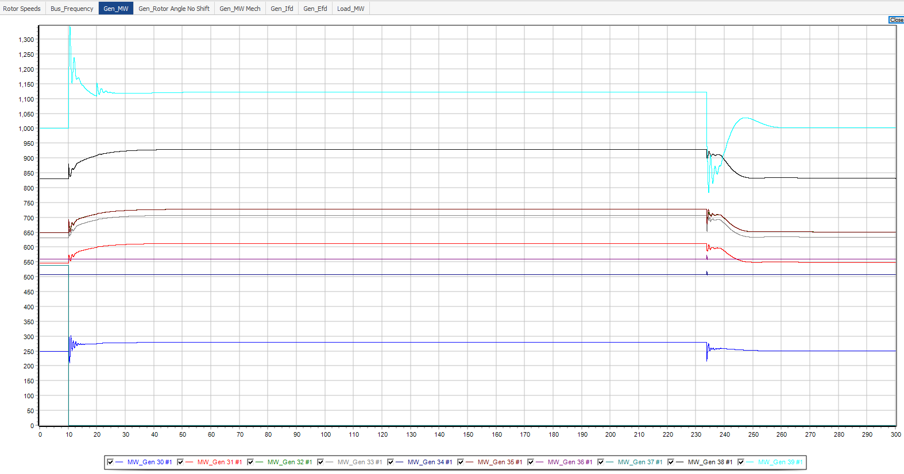
Contingency 1 Results

Slide 15
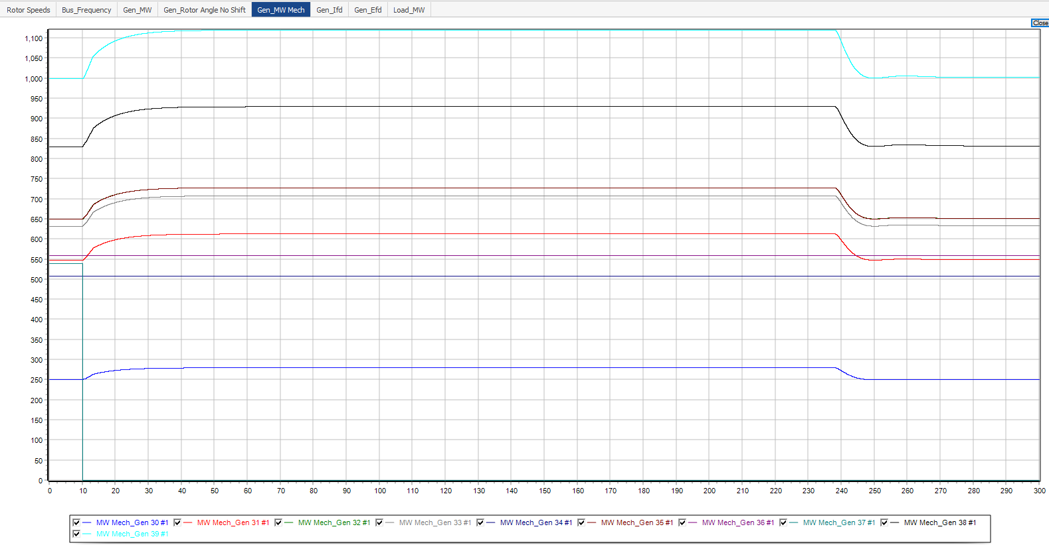
Contingency 1 Results

Slide 16
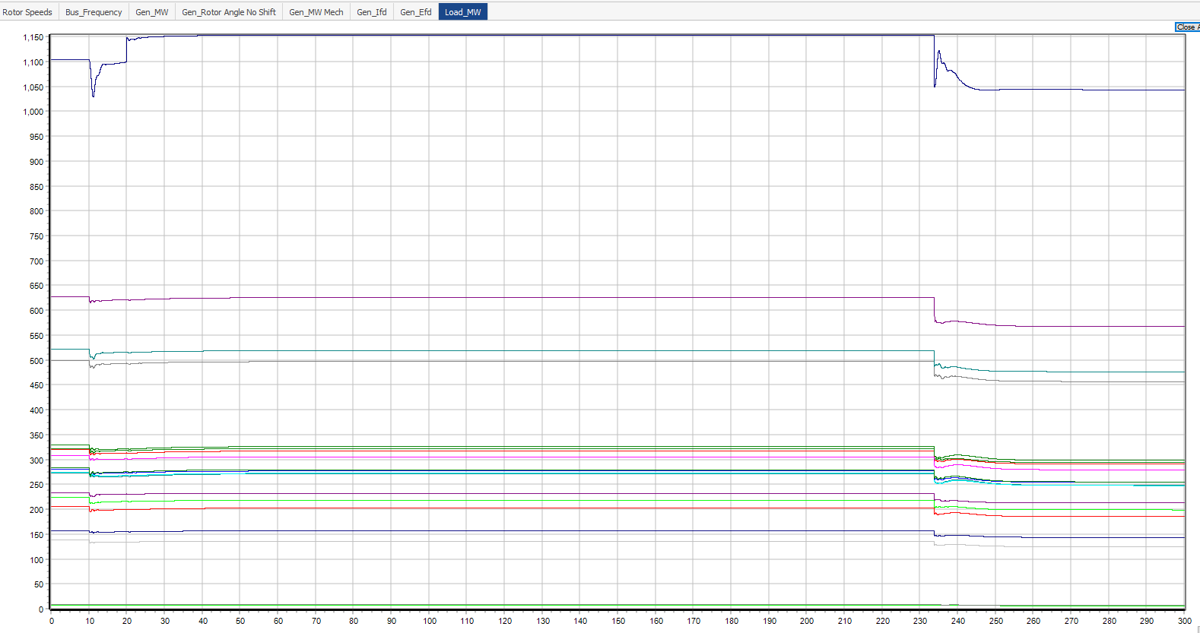
Contingency 1 Results

Slide 17
Returning Gen 37 Online Post Load Shedding @ 300s
Close Gen 37 @ 300s
Set to output its pre-contingency 540 MW output
Contingency: Trip Gen 37 with Load Increase

Slide 18
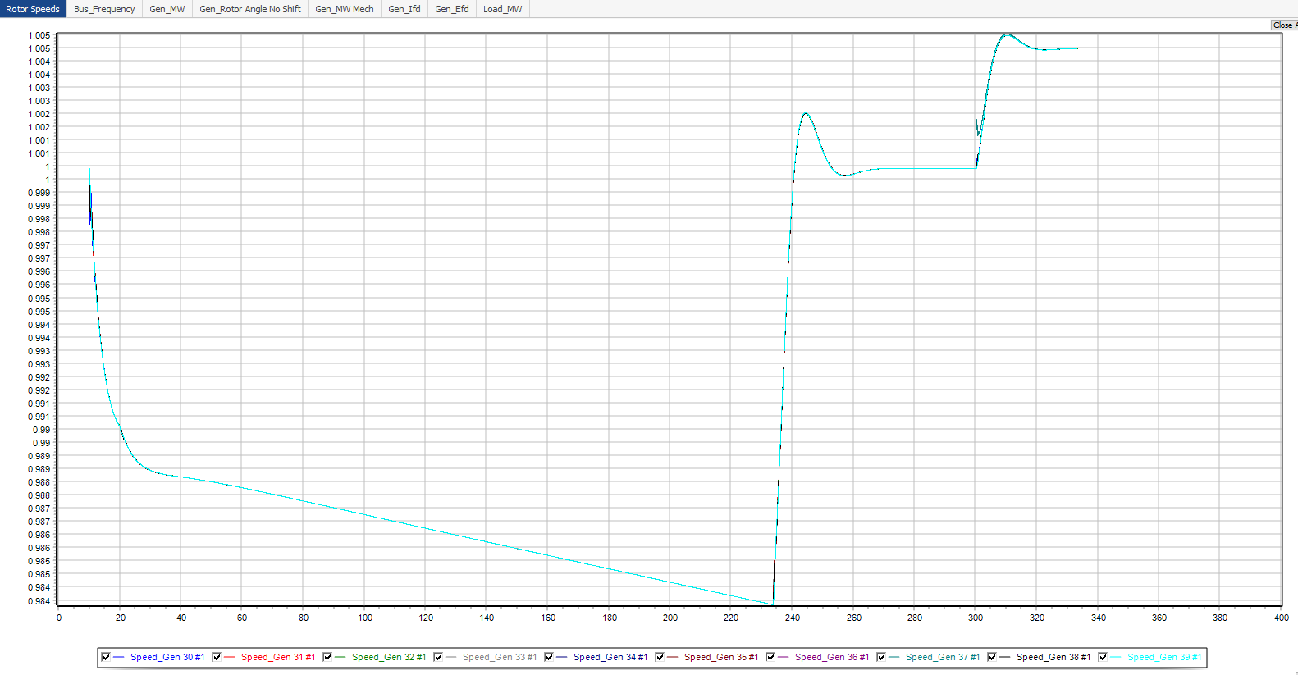
Returning Gen 37 Online Post Load Shedding @ 300s

Slide 19
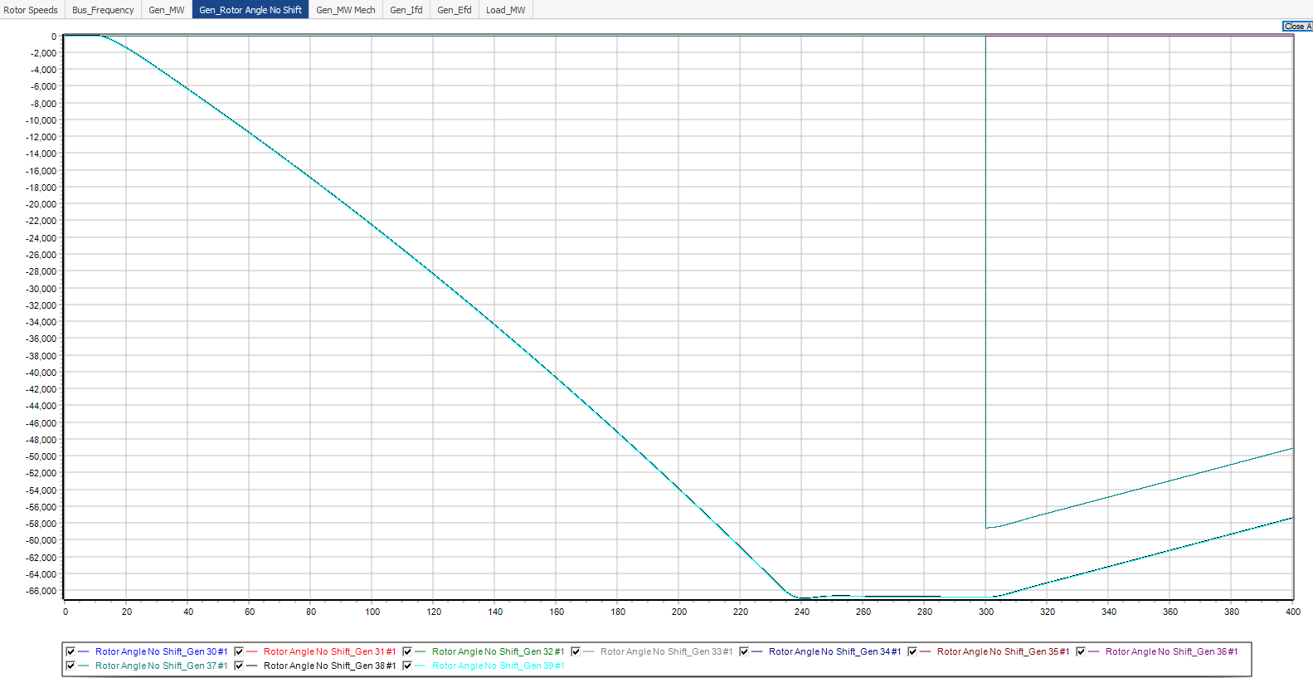
Returning Gen 37 Online Post Load Shedding @ 300s

Slide 20
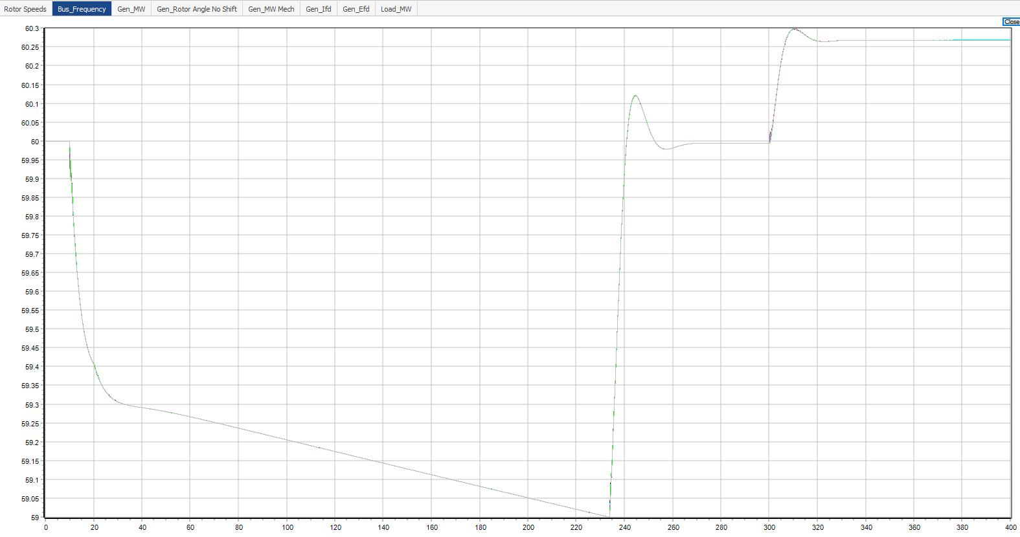
Returning Gen 37 Online Post Load Shedding @ 300s
Stable before Gen 37 is back online
Stable after Gen 37 is back online

Slide 21
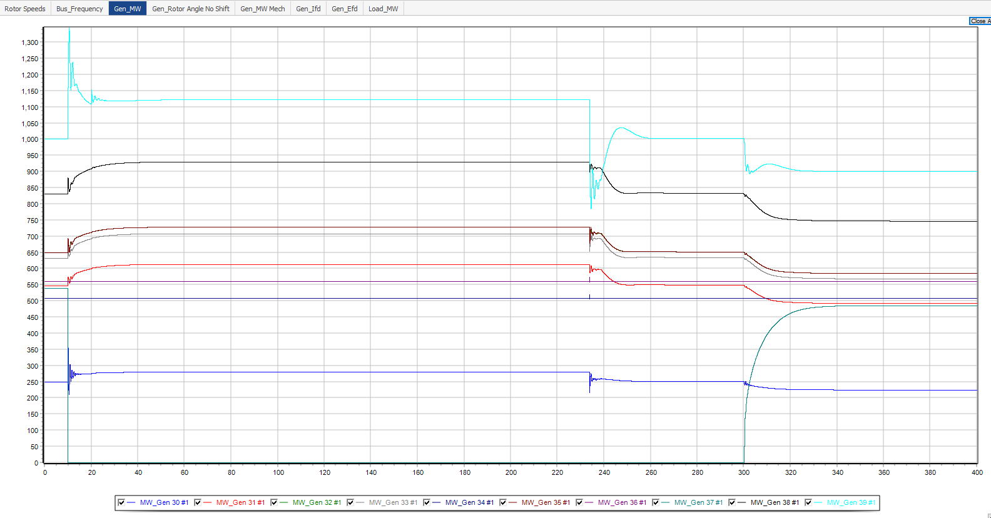
Returning Gen 37 Online Post Load Shedding @ 300s

Slide 22
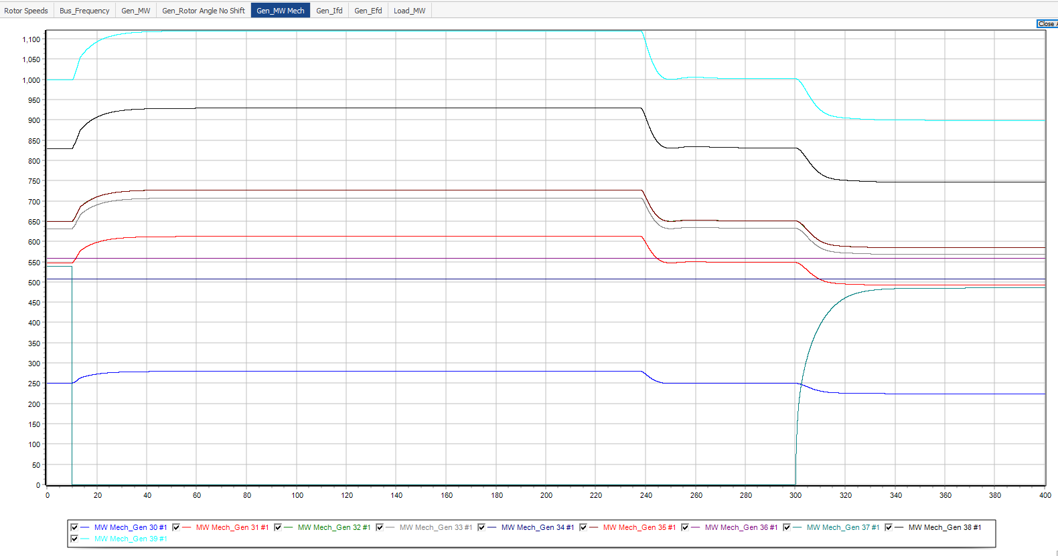
Returning Gen 37 Online Post Load Shedding @ 300s

Slide 23
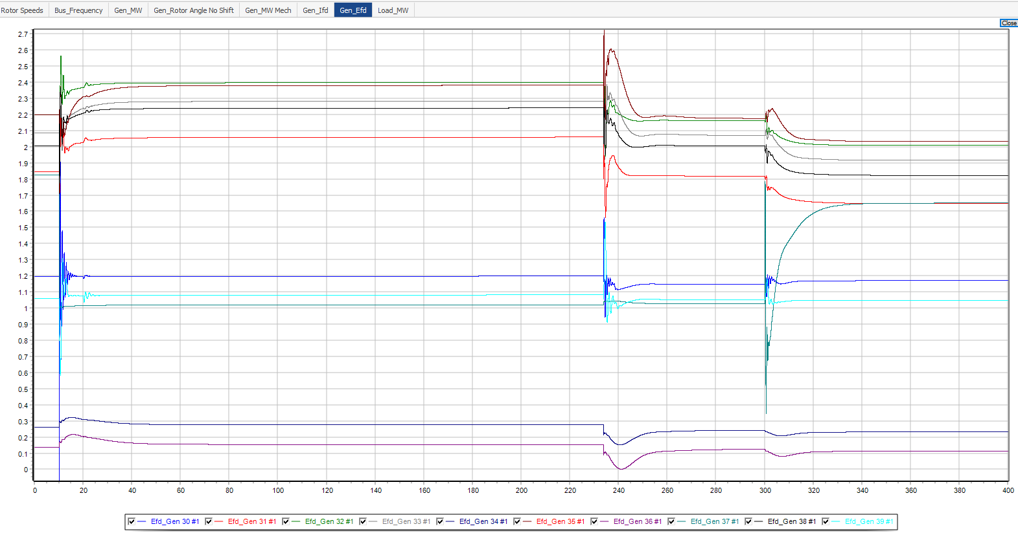
Returning Gen 37 Online Post Load Shedding @ 300s

Slide 24
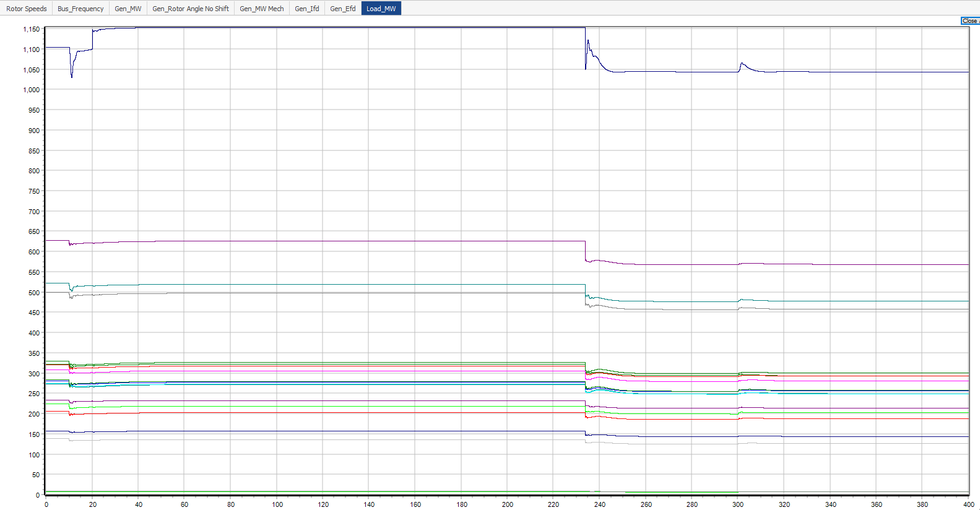
Returning Gen 37 Online Post Load Shedding @ 300s

Slide 25
Contingency 2: Gen Trip and Load Switching FO

Slide 26
Contingency 2: Load switching FO
Apply 0.6Hz load perturbation at Load 39 @ 2 sec
Disconnect Gen 37 @ 10 sec
Initial demand at Load 39: 1104 MW
Test 1:
+/- 50 MW from initial load value
Test 2:
+/- 100 MW from initial load value
Contingency: Load Switching Test 1 – 50MW
Contingency: Load Switching Test 2 – 100MW

Slide 27
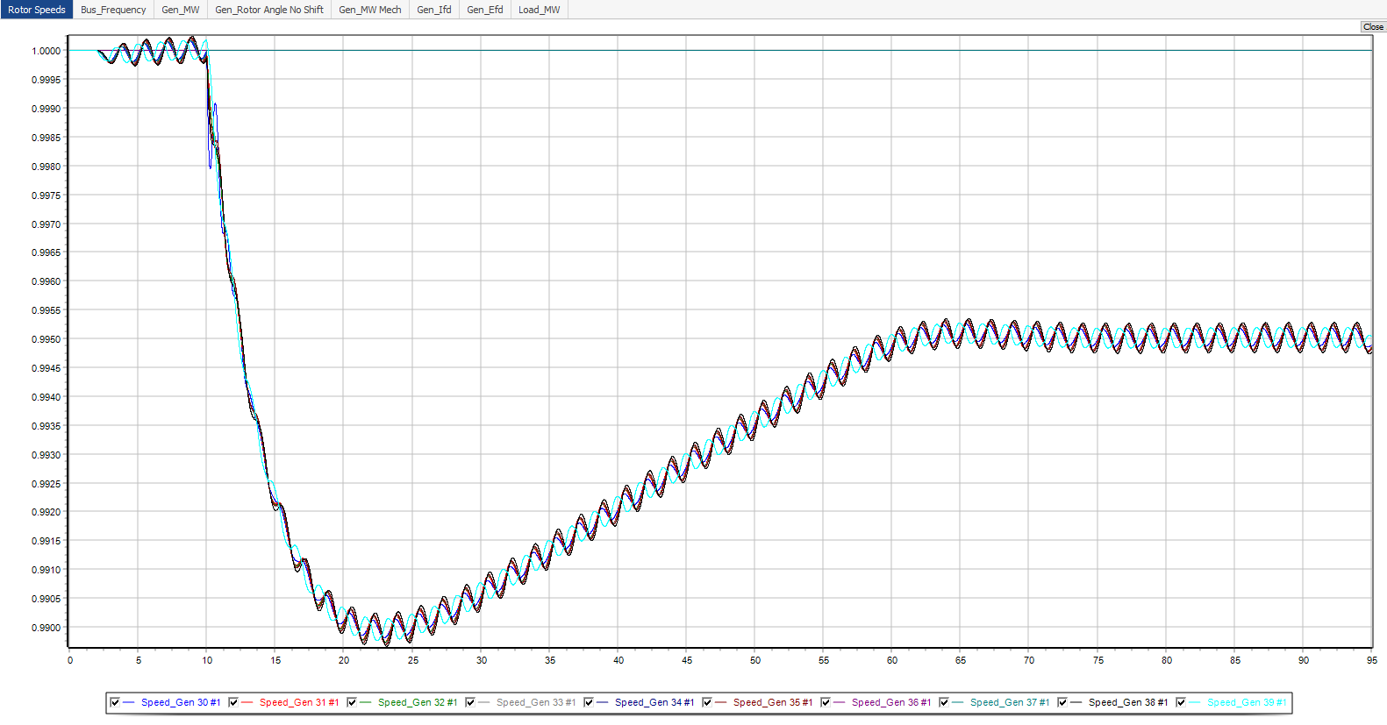
Contingency 2: Test 1 +/- 50 MW

Slide 28
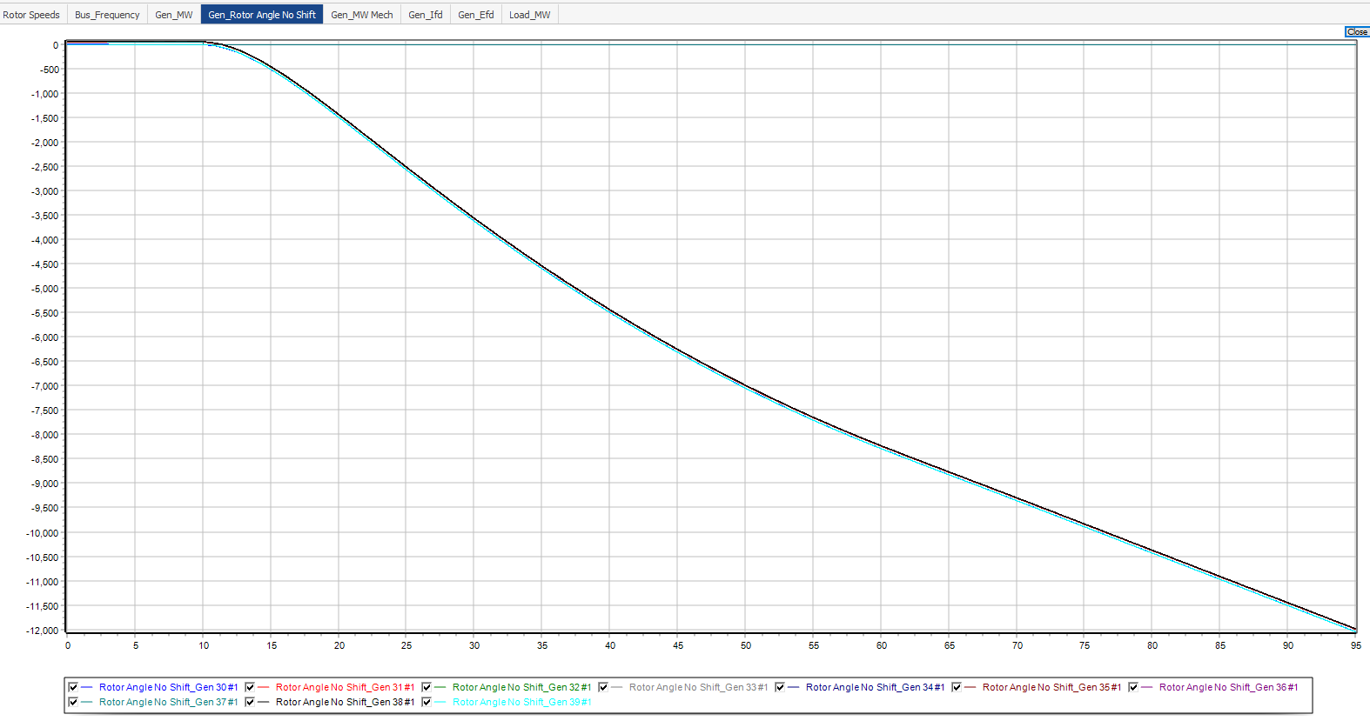
Contingency 2: Test 1 +/- 50 MW

Slide 29
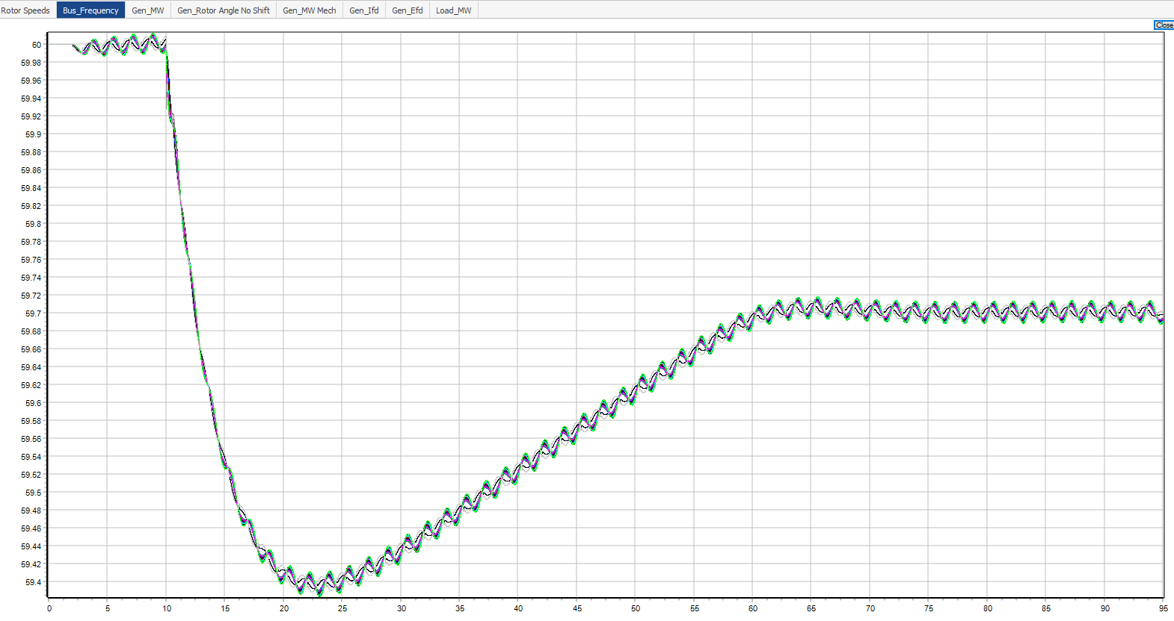
Contingency 2: Test 1 +/- 50 MW
Bus Frequency oscillates on the same trend as just tripping Gen 37 only on slide 5
Min freq > 59 Hz (load shedding freq) therefore the load relay does not trip
Min freq > 59 Hz

Slide 30
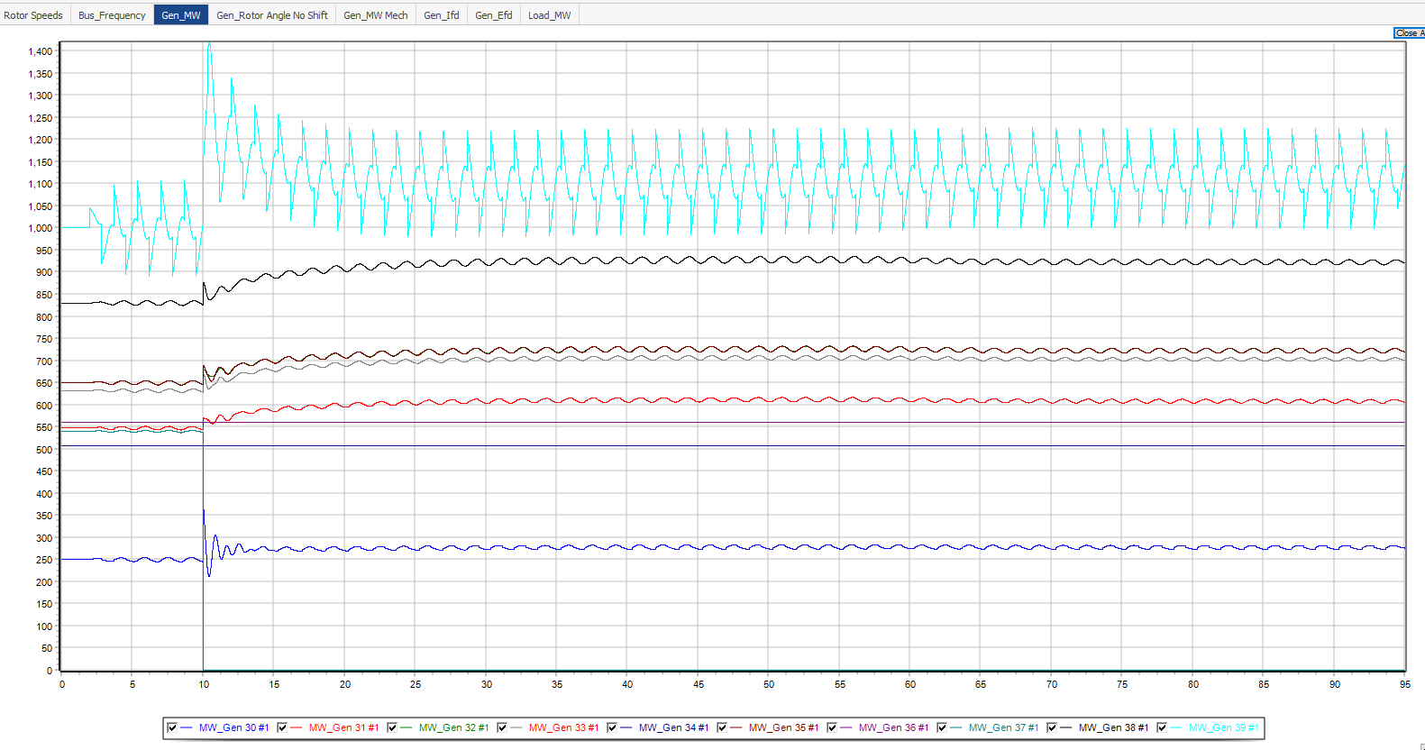
Contingency 2: Test 1 +/- 50 MW

Slide 31
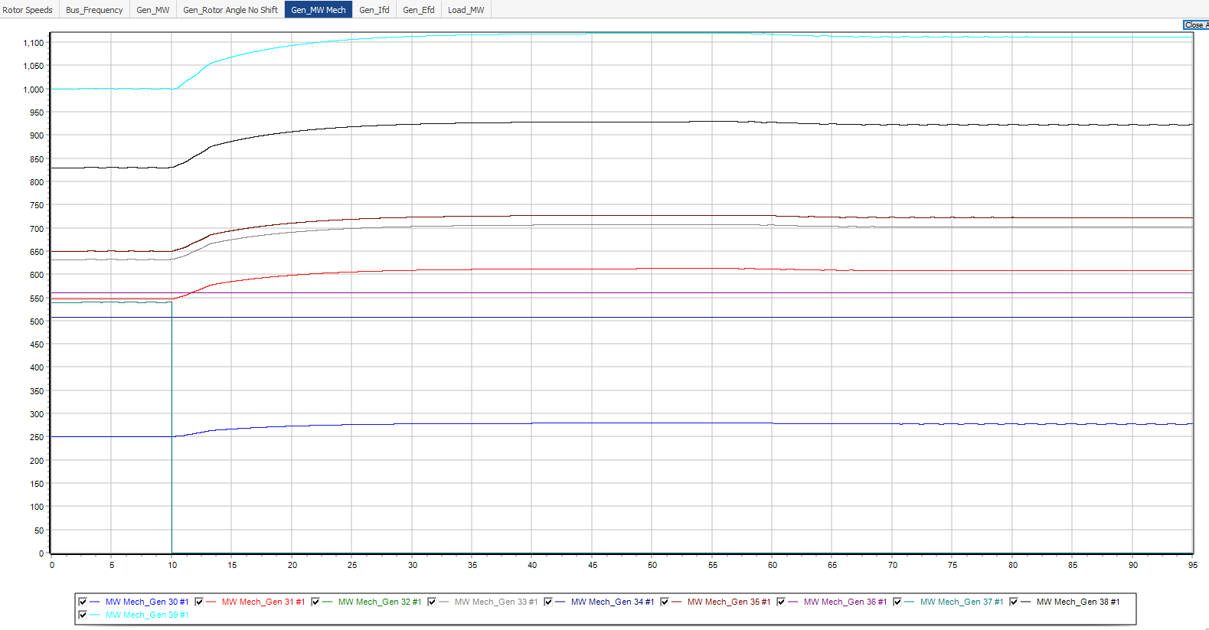
Contingency 2: Test 1 +/- 50 MW

Slide 32
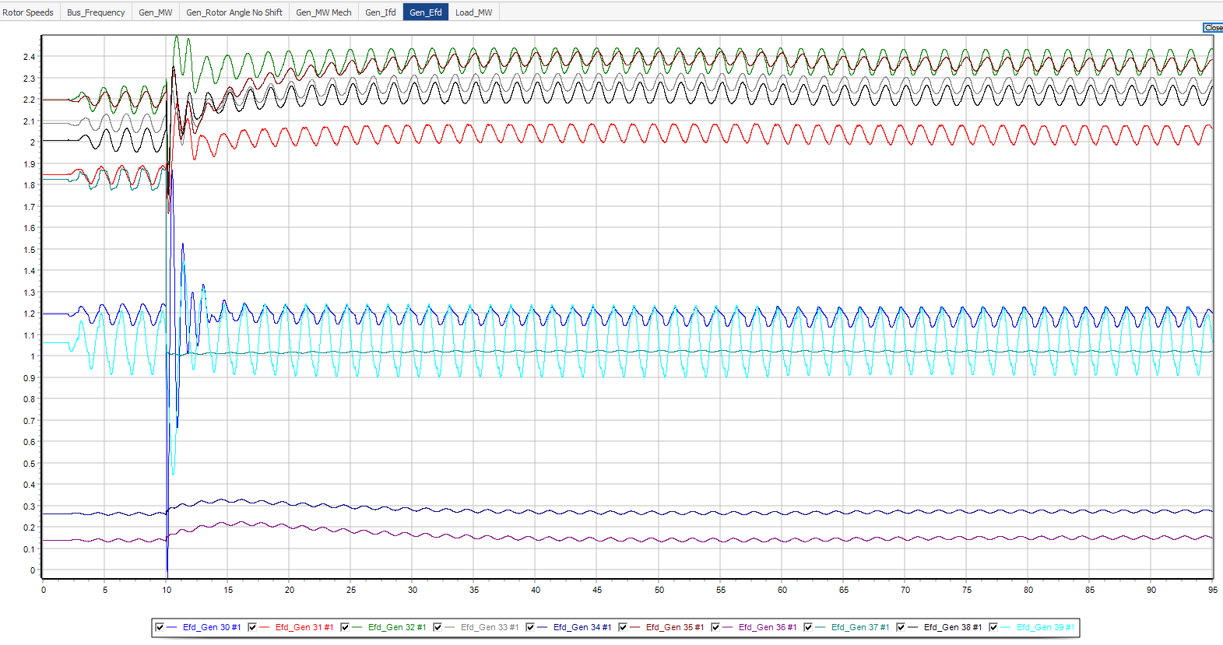
Contingency 2: Test 1 +/- 50 MW

Slide 33
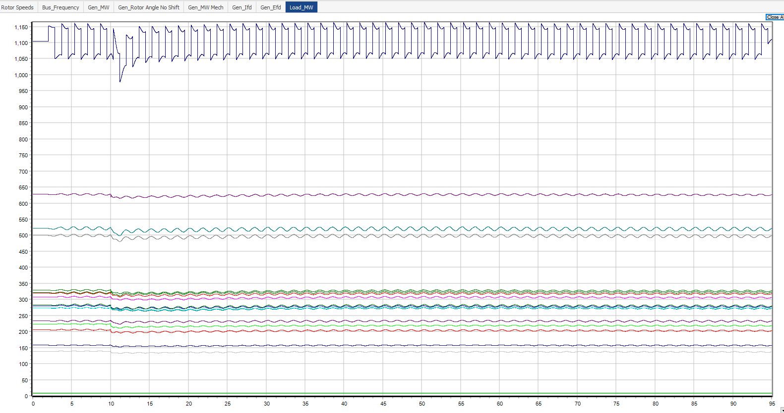
Contingency 2: Test 1 +/- 50 MW

Slide 34
Contingency 2: Test 2 +/- 100 MW
From Test 1, +/- 50 MW was not enough to trigger a load shedding event
Frequency did not drop to 59 Hz
Total Gen Mech MW < Total turbine rated MW (rated turbine MW)
6136 MW < 6174.44 MW
Increase the load perturbation
+/- 100 MW from initial load value
Contingency: Load Switching Test 2 – 100MW

Slide 35
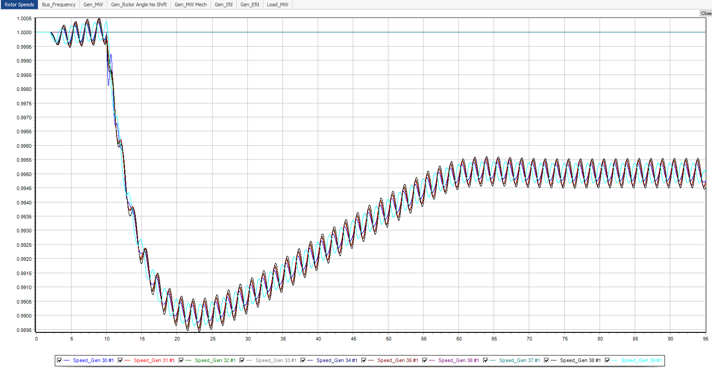
Contingency 2: Test 2 +/- 100 MW

Slide 36
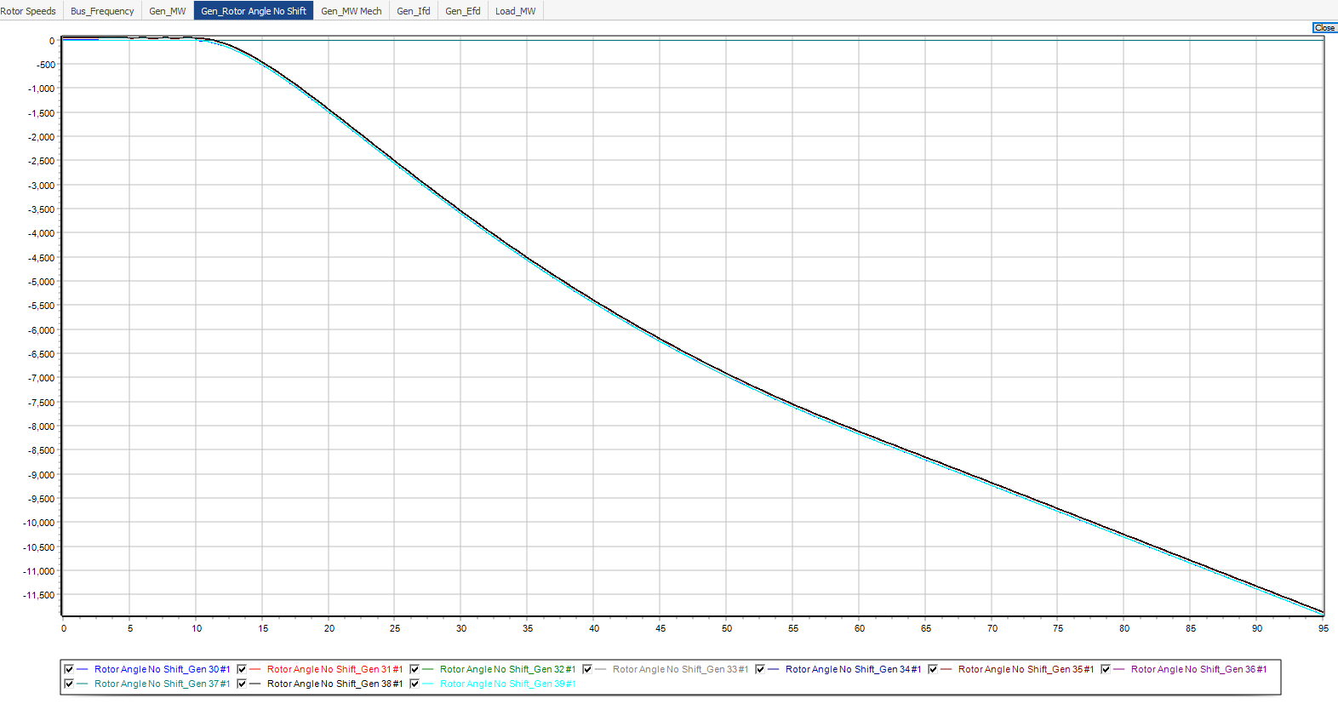
Contingency 2: Test 2 +/- 100 MW

Slide 37
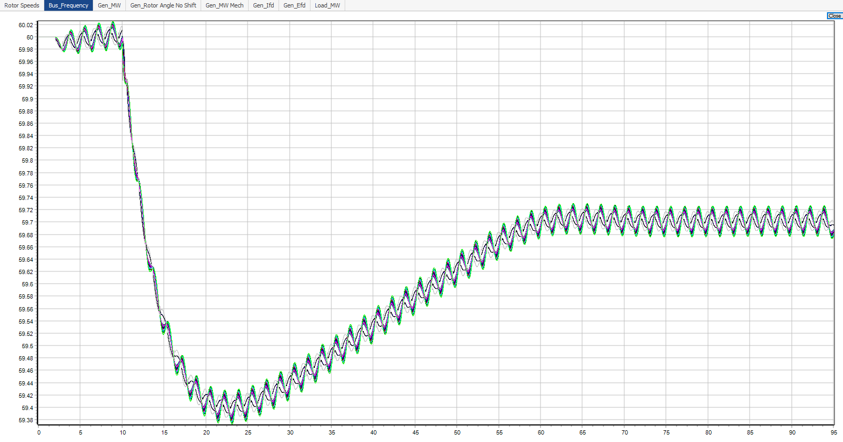
Contingency 2: Test 2 +/- 100 MW
Bus Frequency oscillates on the same trend as just tripping Gen 37 only on slide 5
Min freq > 59 Hz (load shedding freq) therefore the load relay does not trip
Min freq > 59 Hz

Slide 38
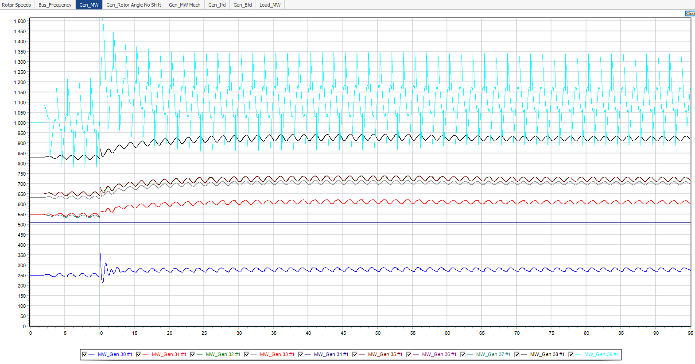
Contingency 2: Test 2 +/- 100 MW

Slide 39
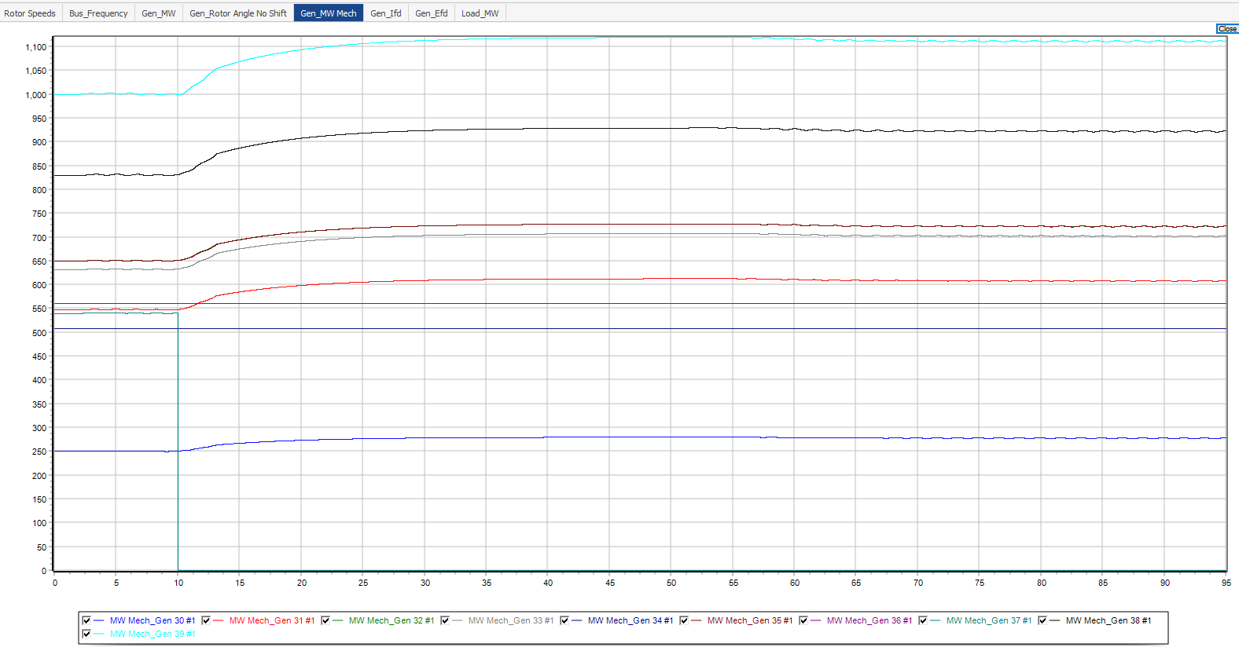
Contingency 2: Test 2 +/- 100 MW

Slide 40
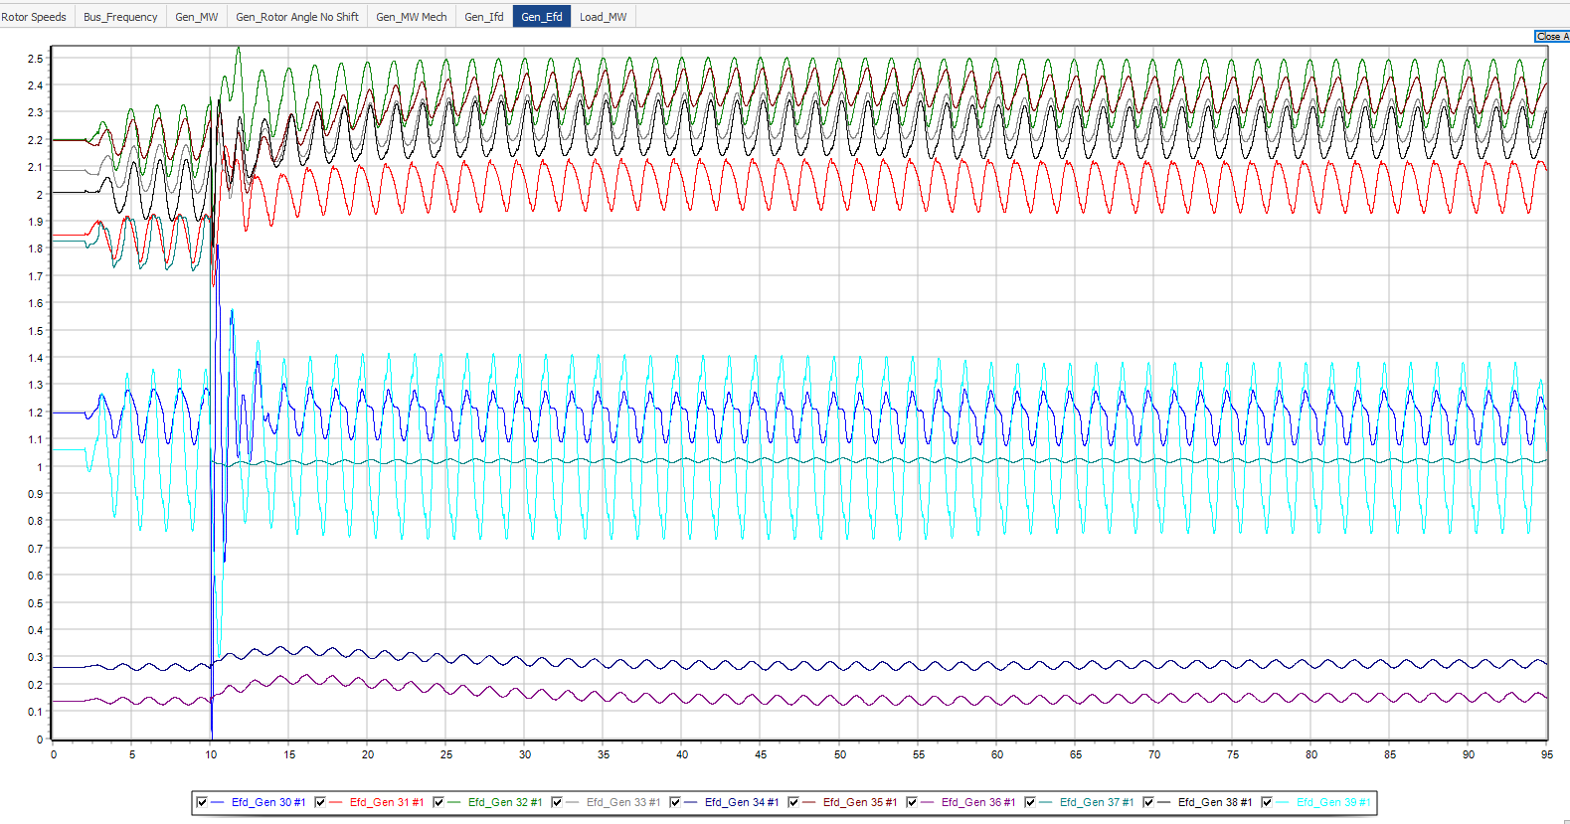
Contingency 2: Test 2 +/- 100 MW

Slide 41
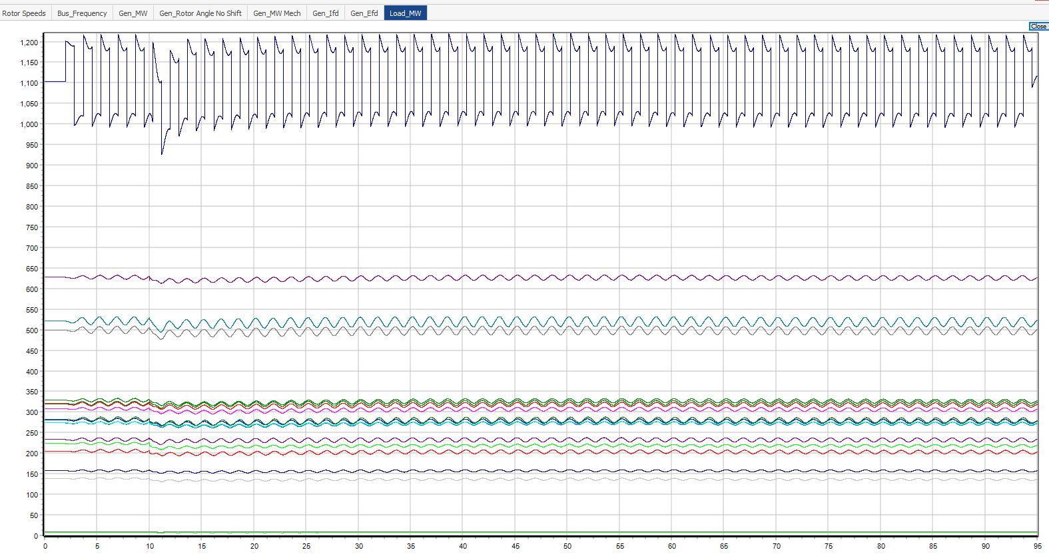
Contingency 2: Test 2 +/- 100 MW

Slide 42
Contingency 2: Test 2 +/- 100 MW
Total Gen Mech MW = 6140 MW
Total Turbine MW rating (excluding Gen 37) = 6174.44 MW
Total Gen Mech MW < Total Turbine MW
System is stable

Slide 43
Contingency 2: Test 3 +/- 200 MW
From Test 2, +/- 100 MW oscillation was unable to trigger load relay trip
Increase the amplitude of the FO to 200 MW
Contingency: Load Switching Test 3 – 200MW

Slide 44
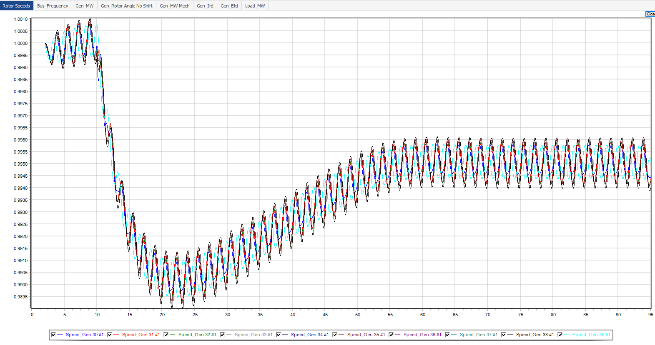
Contingency 2: Test 3 +/- 200 MW

Slide 45

Contingency 2: Test 3 +/- 200 MW

Slide 46
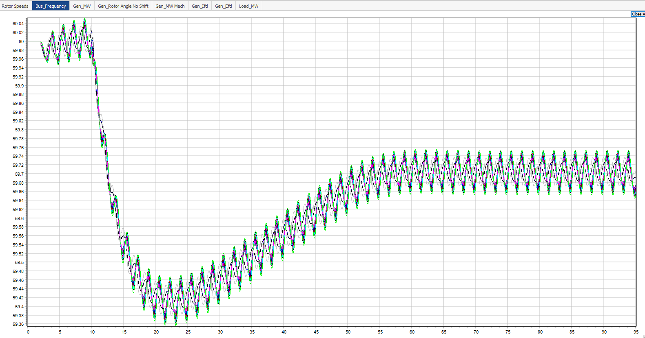
Contingency 2: Test 3 +/- 200 MW
Bus Frequency oscillates on the same trend as just tripping Gen 37 only on slide 5
Min freq > 59 Hz (load shedding freq) therefore the load relay does not trip
Bus Frequency oscillates on the same trend as just tripping Gen 37 only on slide 5
Min freq > 59 Hz (load shedding freq) therefore the load relay does not trip
Min freq > 59 Hz
Min freq > 59 Hz

Slide 47
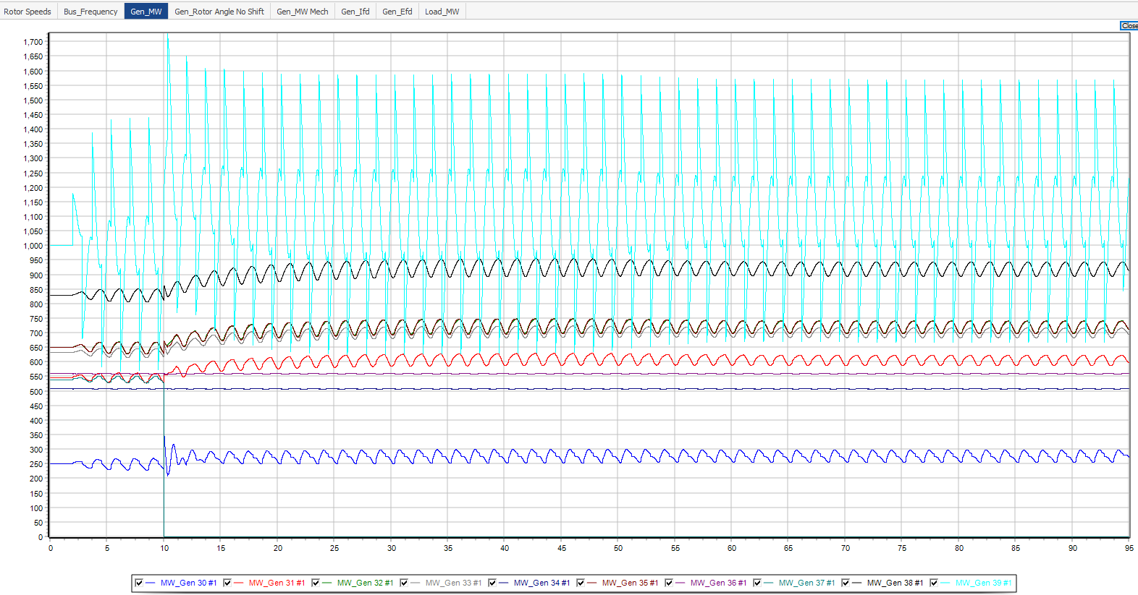
Contingency 2: Test 3 +/- 200 MW

Slide 48
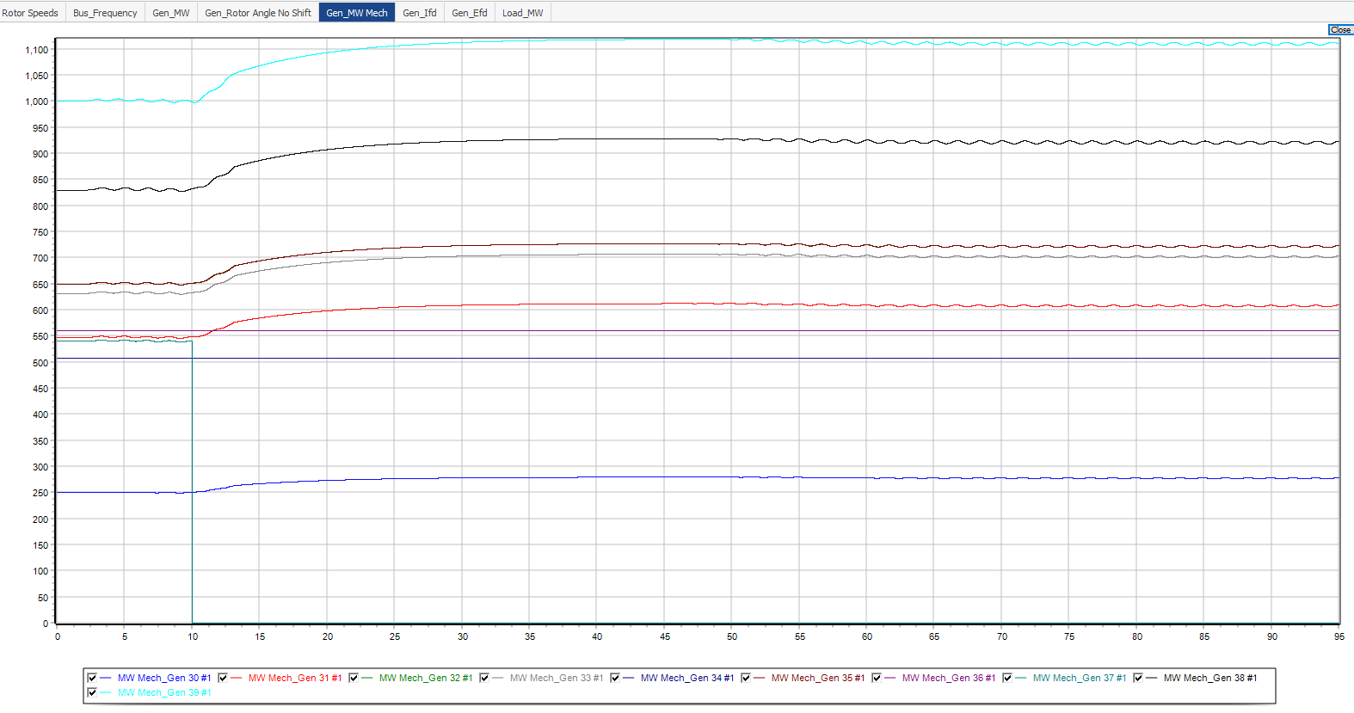
Contingency 2: Test 3 +/- 200 MW

Slide 49
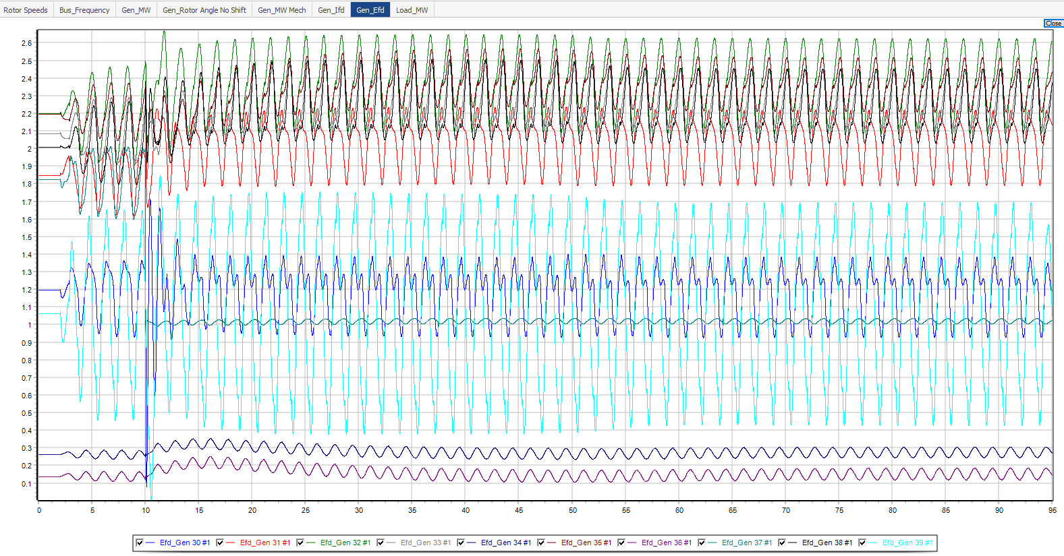
Contingency 2: Test 3 +/- 200 MW

Slide 50
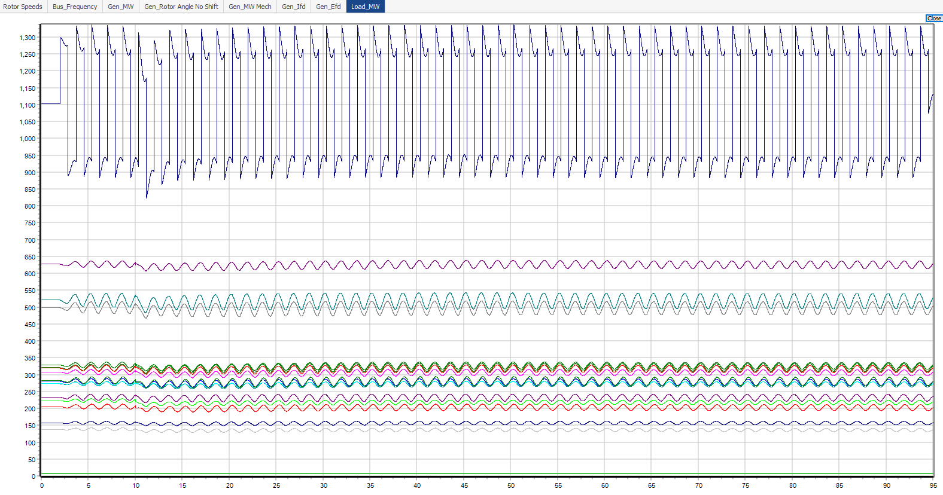
Contingency 2: Test 3 +/- 200 MW

Slide 51
Contingency 2: Test 4 +/- 400 MW
From Test 2, +/- 400 MW oscillation was unable to trigger load relay trip
Increase the amplitude of the FO to 400 MW
Contingency: Load Switching Test 4 – 400MW

Slide 52
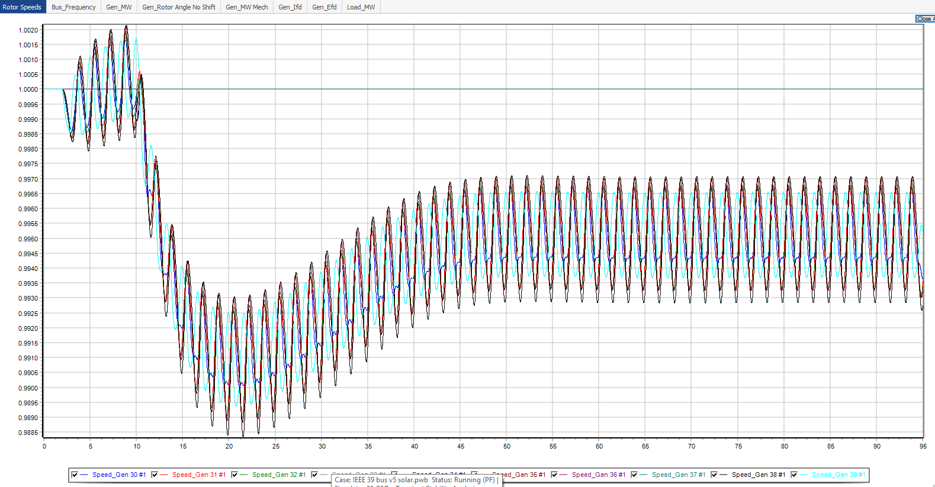
Contingency 2: Test 4 +/- 400 MW

Slide 53
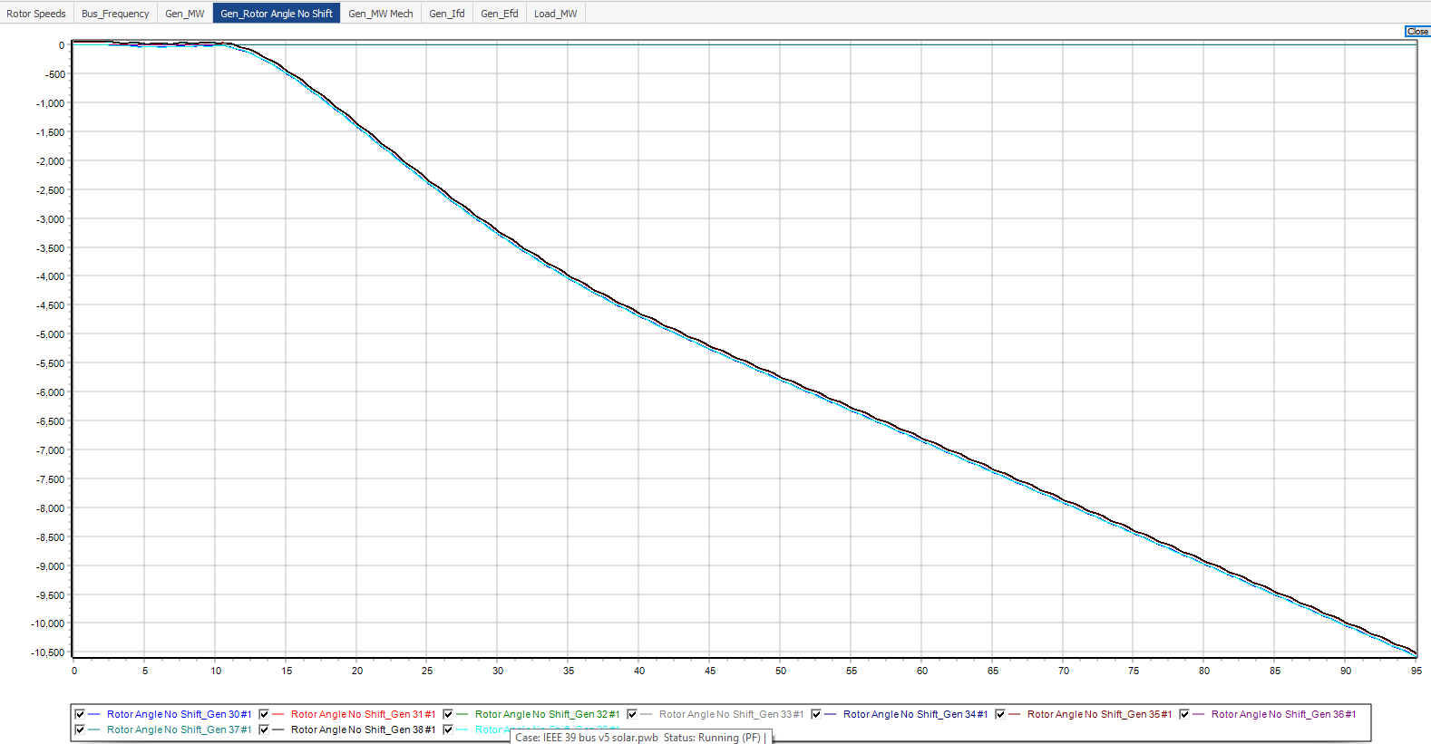
Contingency 2: Test 4 +/- 400 MW

Slide 54
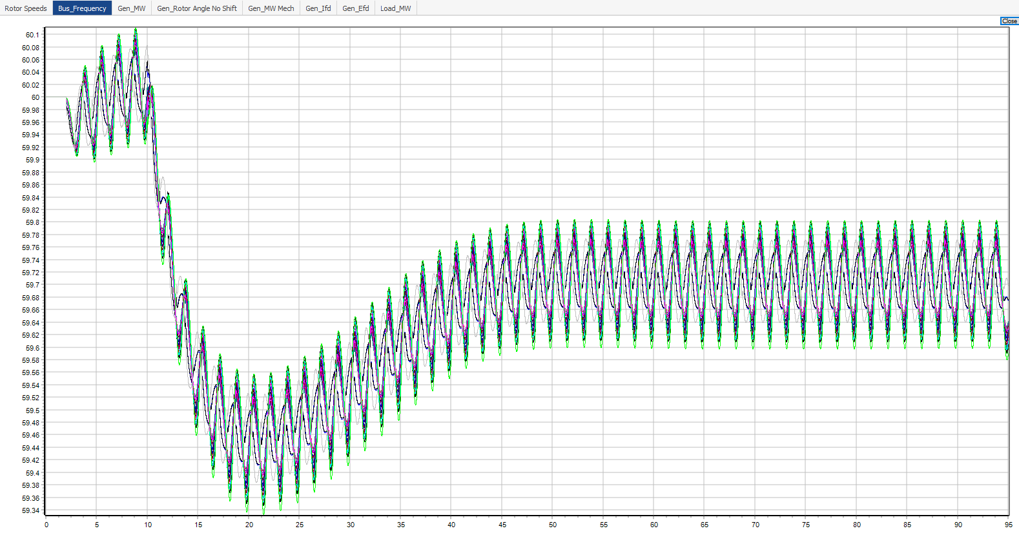
Contingency 2: Test 4 +/- 400 MW
Bus Frequency oscillates on the same trend as just tripping Gen 37 only on slide 5
Min freq > 59 Hz (load shedding freq) therefore the load relay does not trip
Min freq > 59 Hz

Slide 55
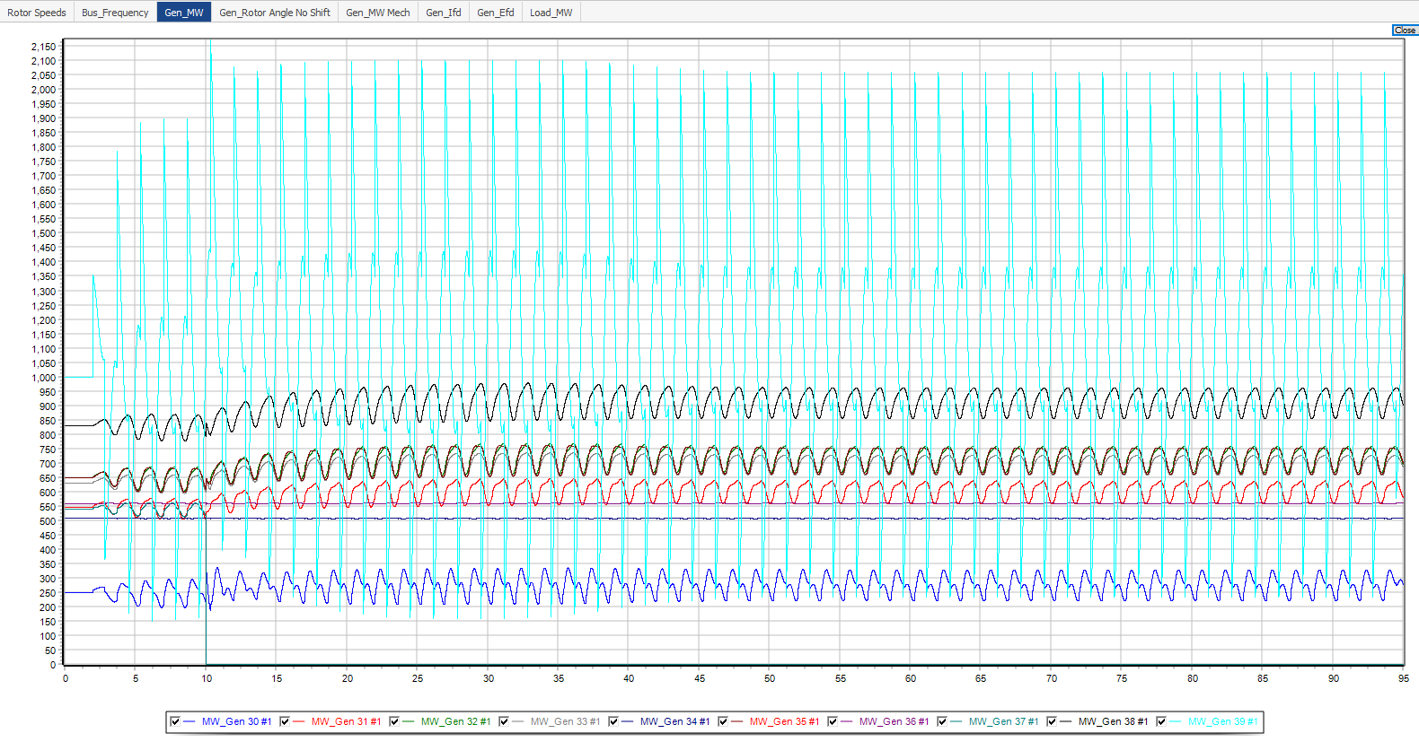
Contingency 2: Test 4 +/- 400 MW

Slide 56
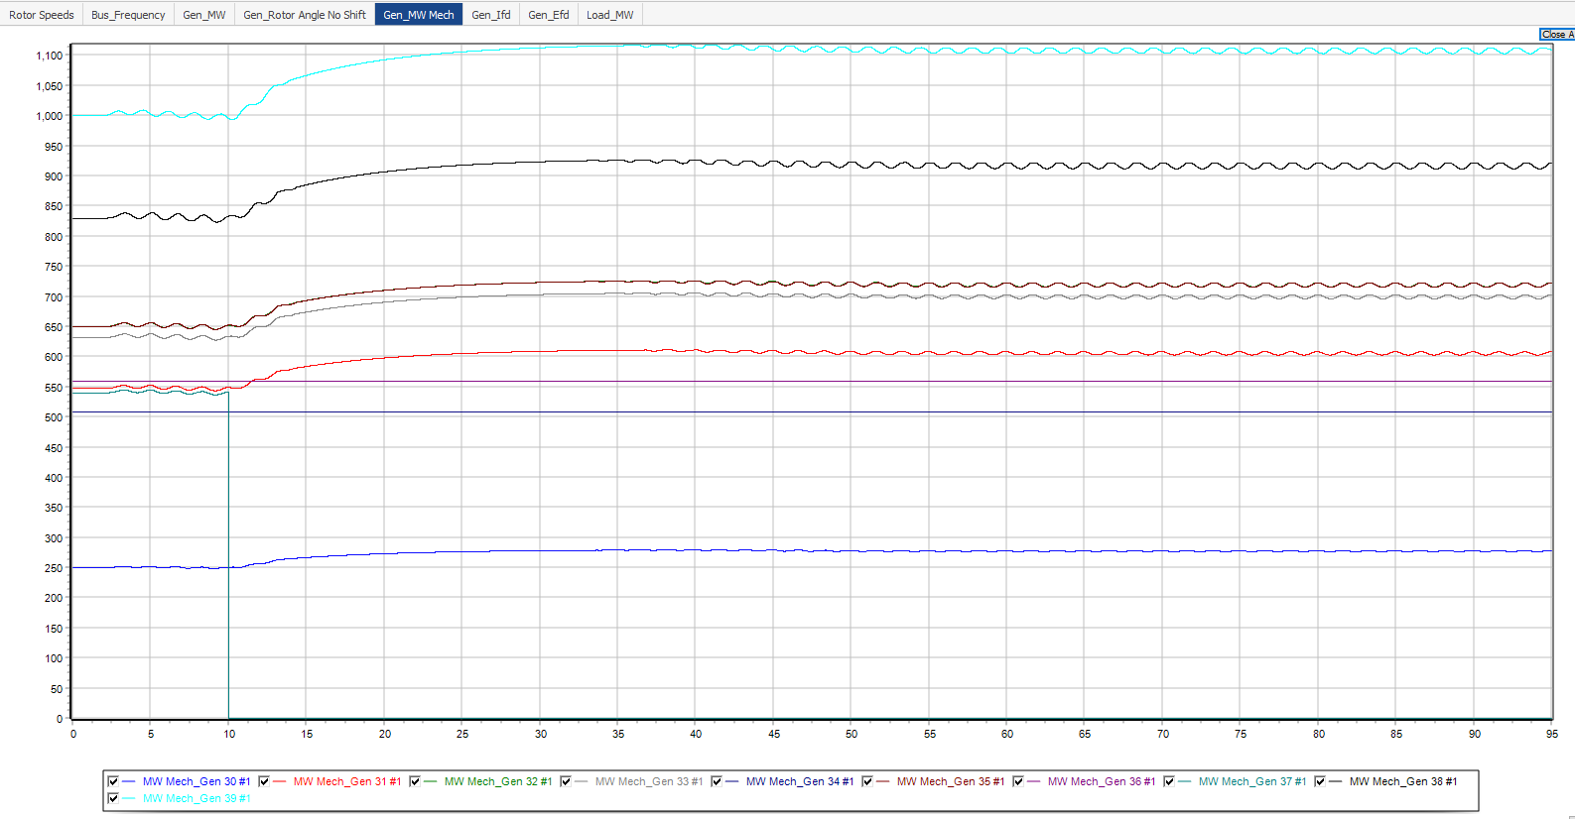
Contingency 2: Test 4 +/- 400 MW

Slide 57
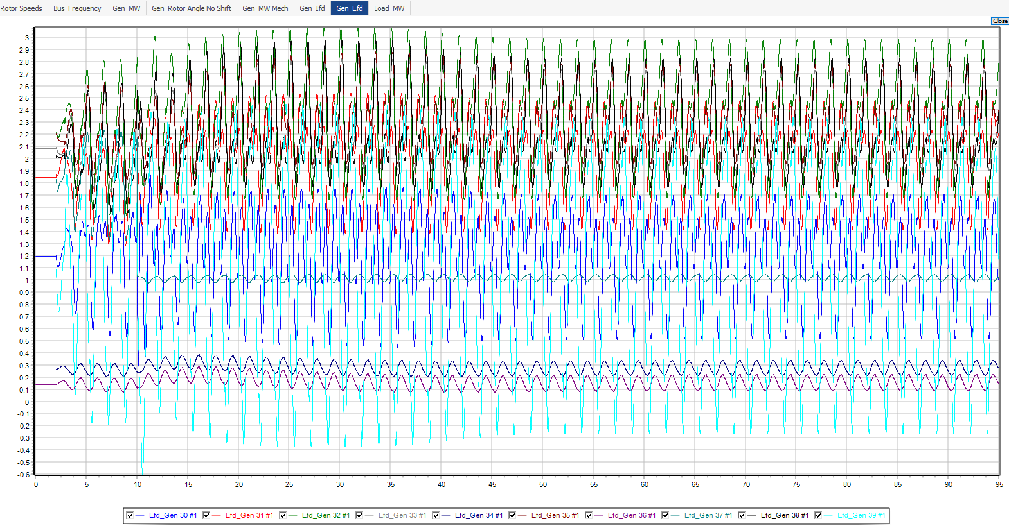
Contingency 2: Test 4 +/- 400 MW

Slide 58
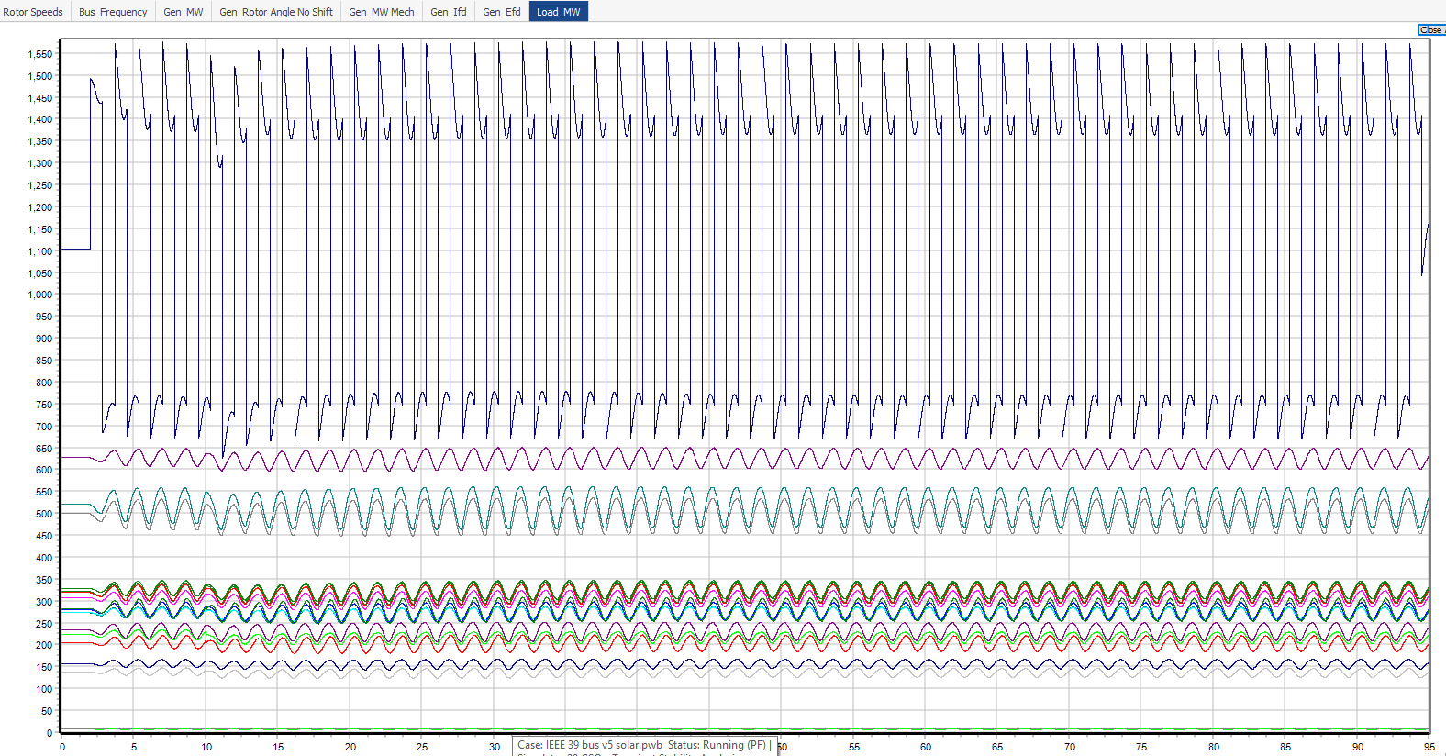
Contingency 2: Test 4 +/- 400 MW

Slide 59
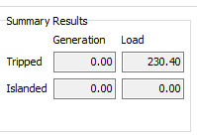
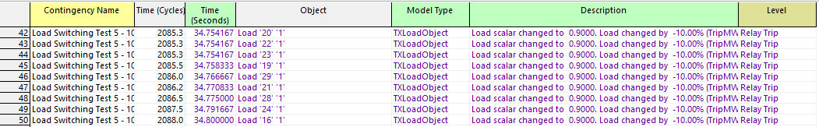
Contingency 2: Test 5 +/- 100 MW with bias
From Test 4, +/- 400 MW oscillation was unable to trigger load relay trip
Introduce a constant bias in addition to +/- 100 MW load switching FO
Any bias greater than 50 MW will cause the frequency to drop
100 MW bias was introduced, load relay trips @ 34.75s
Total of 230.4 MW load was tripped
Note: a bias of 50 MW takes longer than 125s for the frequency to drop to 59 Hz (slide 68)
Contingency: Load Switching Test 5 – 100 MW with 100 MW bias

Slide 60
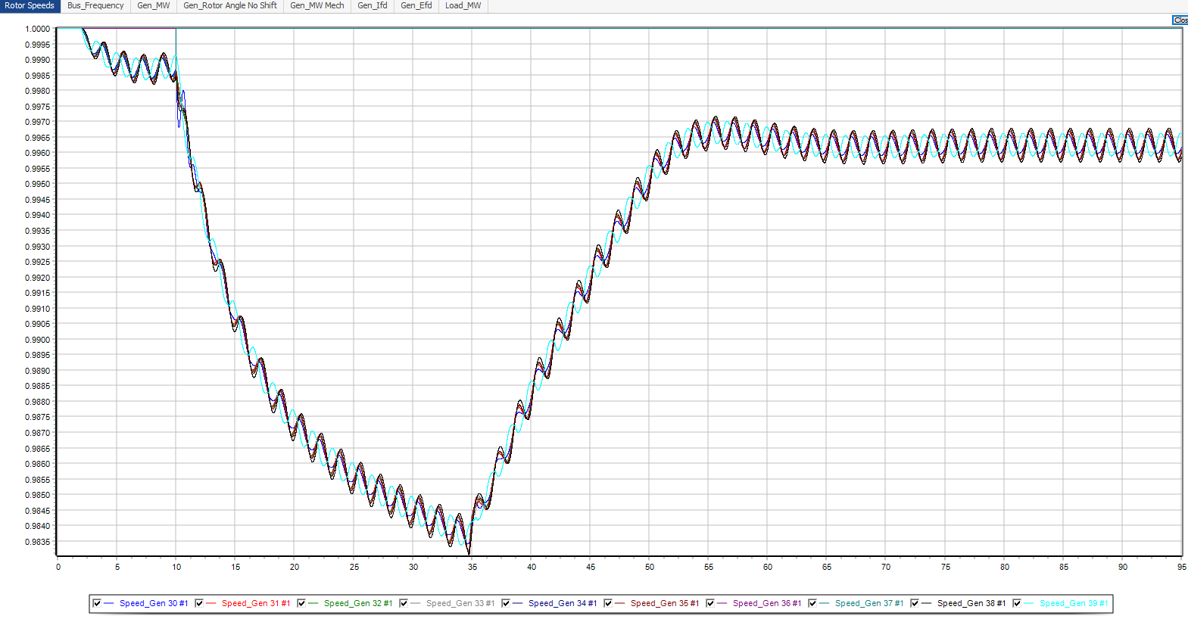
Contingency 2: Test 5 +/- 100 MW with 100 MW bias

Slide 61
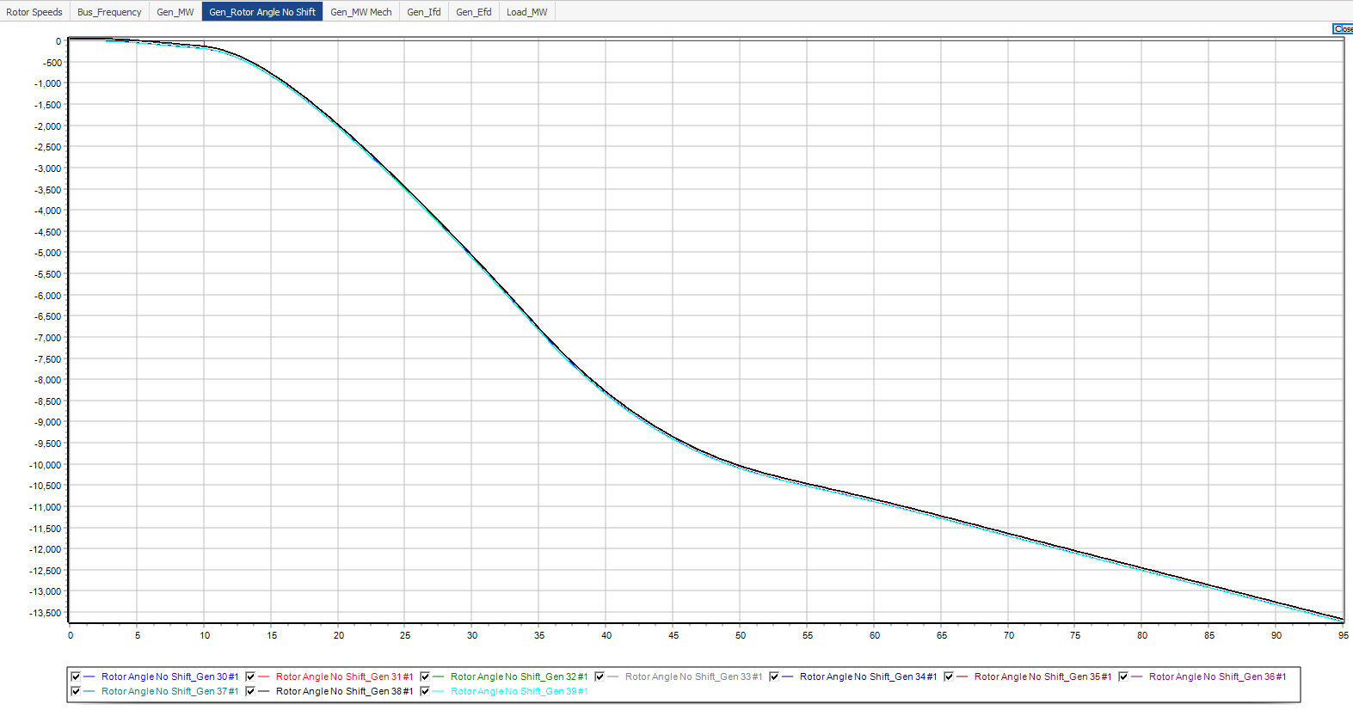
Contingency 2: Test 5 +/- 100 MW with 100 MW bias

Slide 62
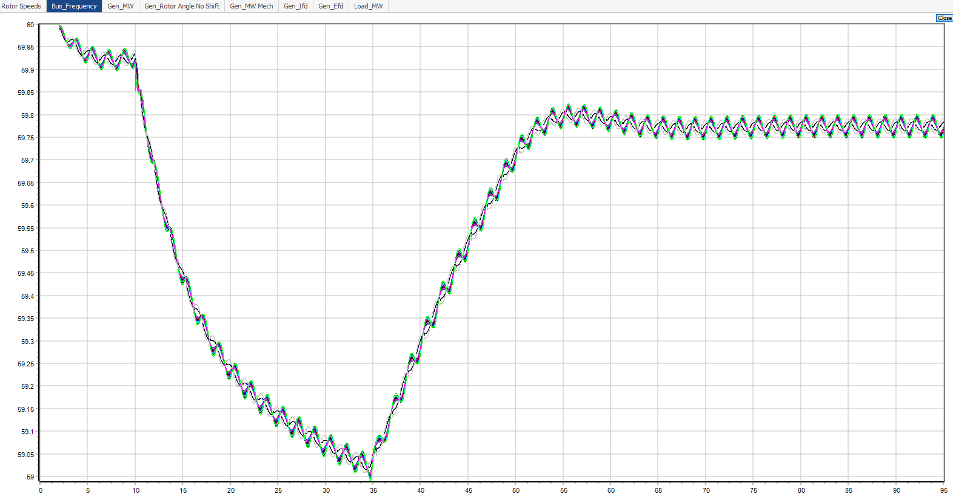
Contingency 2: Test 5 +/- 100 MW with 100 MW bias
Load Relay Trip

Slide 63
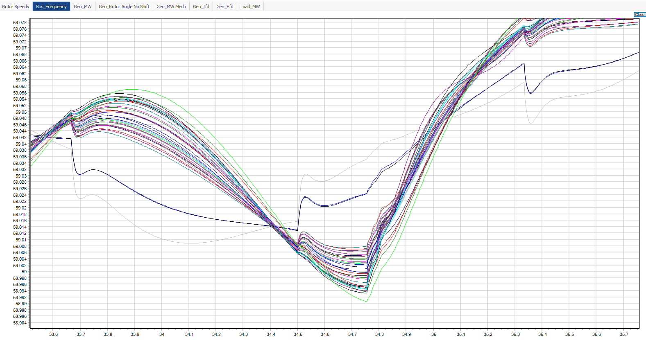
Contingency 2: Test 5 +/- 100 MW with 100 MW bias
Zoom in of bus frequency
Shows frequency for all buses (non-load and load buses)

Slide 64
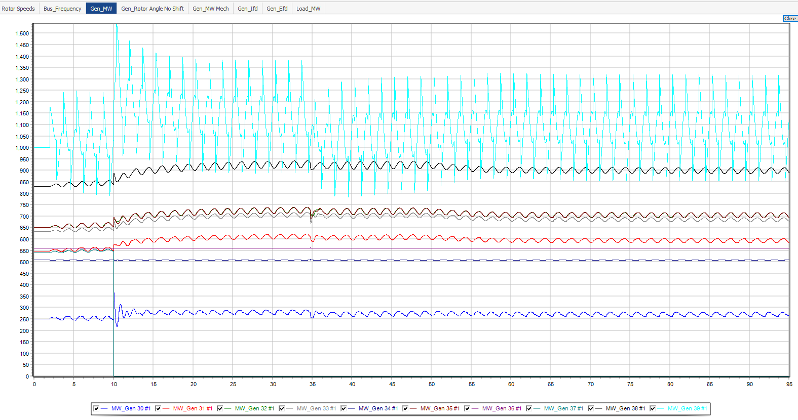
Contingency 2: Test 5 +/- 100 MW with 100 MW bias

Slide 65

Contingency 2: Test 5 +/- 100 MW with 100 MW bias

Slide 66

Contingency 2: Test 5 +/- 100 MW with 100 MW bias

Slide 67

Contingency 2: Test 5 +/- 100 MW with 100 MW bias

Slide 68

Contingency 2: Test 5 +/- 100 MW with 50 MW bias
Contingency: Load Switching Test 5 – 100 MW with 50 MW bias

